Slide 1




Career Tracking Platform for Skilled Youth
Mastercard Code for Change Hackathon 2025
Sponsered by Y4D
Team No : 15
Team Members : Anjali Phule
Mahima Bhagwat
Vaishnavi Karpe
Shubham Garg
Hemant Marathe
Anurag Daundkar
Prathamesh Ghadge

Slide 2
Problem Statement
Y4D Skilling Programs aim to improve employability and support underserved communities.
Current models provide training and job placements but do not track progress after placements.
Challenges faced include:
- The inability to track long-term career progress of beneficiaries.
- No centralized platform for updated beneficiary data.
- Reliance on manual methods, such as calls and field visits, which are time-consuming, inconsistent,
and incomplete.
- Difficulty in measuring impact and growth after initial placement.
- A need for a structured digital solution to track career progress, collect data, and generate insights.
The solution must ensure data privacy, security, and scalability.
2

Slide 3
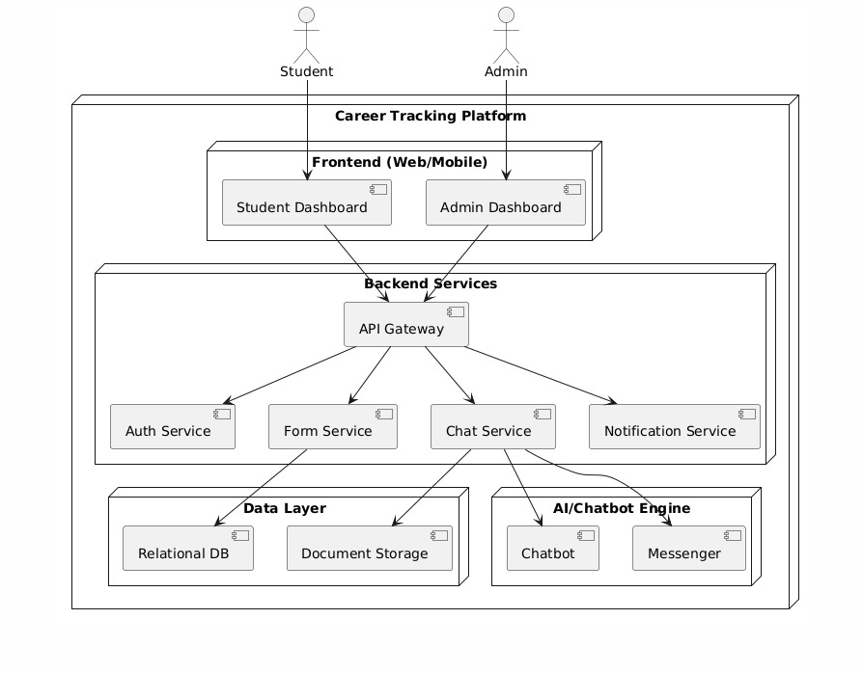


Solution Overview
Student
Admin
3

Slide 4
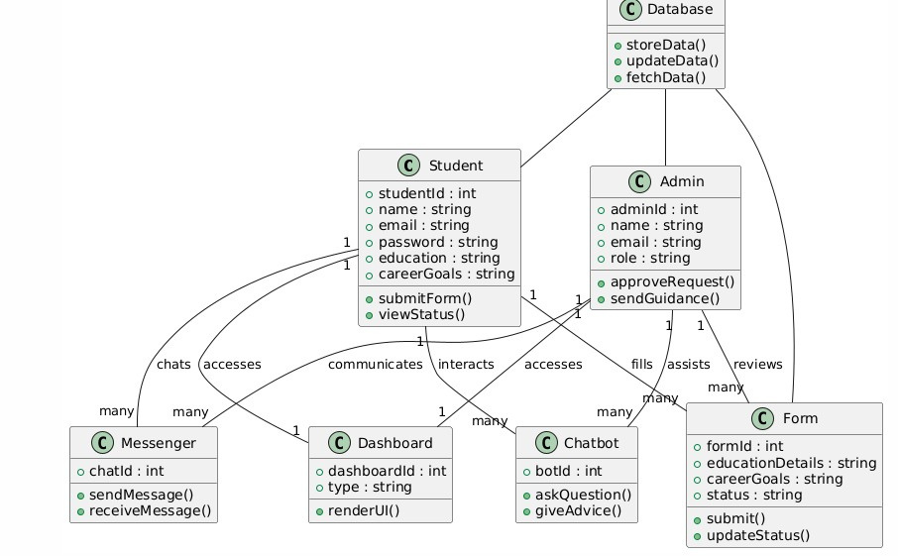
Demo/Prototype
4
August 20, 2024

Slide 5
https://drive.google.com/file/d/1kMaVW4LDJl8O8ZCo2KS-05cnd94xMbak/view?usp=sharing

Slide 6





Technology Stack
Frontend
Backend
Database
React Tailwind CSS
Node js Spring Boot
MongoDB
Github Repository Link
https://github.com/Mastercard-Code-For-Change-2-0/Team-15

Slide 7
Impact
Interactive Guidance
Chatbots & notifications keep students active
Streamlined career tracking
Reduces manual effort & errors
Improved engagement
Students stay connected with Y4D beyond placement
Future scope
Resume Building & Career Guidance
Automated resume builder from student data
Skill Upgradation
Personalized course recommendations based on career goals
Alumni & Networking Platform
Alumni community for peer-to-peer learning and mentorship of new students
6
August 20, 2024

Slide 8
Q&A
7
August 20, 2024

